Slide 1
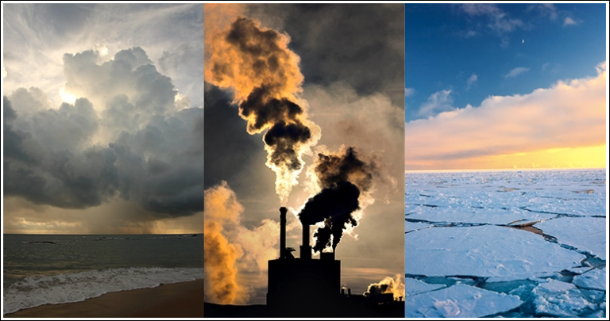
Weathering the Heat: Ecology and Earth’s Climate System
by Anne Fernald Cross, Phd
Spring 2023
Notes:
Image from: https://climate.nasa.gov/global-warming-vs-climate-change/
Instructors; ask your students: Why the insect silhouettes are included on this slide? Identify the insect or ecotherm?
Climate determines the global distribution of living organisms; whereas, weather determines the local, short-term environment of living organisms. Life thrives within specific, often narrow ranges of temperature and precipitation. This 10-lesson module creates a science-based story connecting living organisms to the five components of the global environment – atmosphere, biosphere, cryosphere, hydrosphere, and geosphere. Using a systems-based approach, the module first reviews background information on climate, weather, the greenhouse effect, and greenhouse gases (GHG). Second, the module introduces connections between humanity’s GHG emissions, radiative forcing and current- and projected temperatures on Earth. Lastly, the module focuses on scientific communication with a short New York Times article and a peer-reviewed paper, considering whether humanity can be hopeful in the face of climate change. This module considers not only what you should know, but also how you know it and how you can use that knowledge. The module also focuses on timely and current information that is in the news – climate change, global warming and human health.

Slide 2
BACKround Information Climate, Weather, the Greenhouse Effect, Greenhouse Gases, and Species’ range shifts
Guiding Questions:
What’s the difference between climate and weather?
How does the systems-based approach show connections between Earth’s atmosphere, biosphere, cryosphere, hydrosphere and geosphere?
How do humans influence Earth’s climate system?
How do you think plant and animal species will respond to climate change?

Slide 3
You will learn to:
Distinguish climate from weather
Identify five components of the climate system and explain their role in global energy transfer
Review the Greenhouse Effect: Natural and Human-enhanced
Discover how forcings, feedbacks, and tipping points influence Earth's climate system
Explore the components of radiative forcing
Identify greenhouse gases (GHG)—CO₂, methane (CH₄), water vapor (H₂O), nitrous oxides (NO_{x}), fluorinated-gases (F-gas)
Examine NASA data on global temperature and atmospheric carbon dioxide (CO₂) concentrations
Explore the link between climate change and species’ range shifts for vegetation and insects
Review and collate data (from the 8 previous lessons) in a data table with a classmate or individual
Discuss the data (from above) with a classmate and summarize the “big ideas” in 3 statements
Ponder whether humanity can remain hopeful in the face of climate change

Slide 4
Instructions for Students
The learning module contains 10 lessons; one of which is review.
The Learning Objectives state the purpose of each lesson. A video link or a website link leads the you through the primary content of the lesson. Following the presentation of content, the you complete a low-stakes assessment– fill-in-the-blank, short essay, make a drawing, true/false, or multiple choice.
This lesson may be instructor-led, student-led or allow students to work online on the material at a pace that best supports individual understanding and learning.
You may collaborate with one or two classmates with on this assignment.
Each student is responsible for submitting their own work, as work completed with or copied from other students earns no points.

Slide 5
OVERVIEW
Individual lessons are presented in numerical order
Each lesson has two parts:
a slide or video presentation
an assessment
Notes:
Climate determines the global distribution of living organisms; whereas, weather determines the local, short-term environment of living organisms. Life thrives within specific, often narrow ranges of temperature and precipitation. This 10-lesson module creates a science-based story connecting living organisms to the five components of the global environment – atmosphere, biosphere, cryosphere, hydrosphere, and geosphere. Using a systems-based approach, the module first reviews background information on climate, weather, the greenhouse effect, and greenhouse gases (GHG). Second, the module introduces connections between humanity’s GHG emissions, radiative forcing and current- and projected temperatures on Earth. Lastly, the module focuses on scientific communication with a short New York Times article and a peer-reviewed paper, considering whether humanity can be hopeful in the face of climate change. This module considers not only what you should know, but also how you know it and how you can use that knowledge. The module also focuses on timely and current information that is in the news – climate change, global warming and human health.

Slide 6
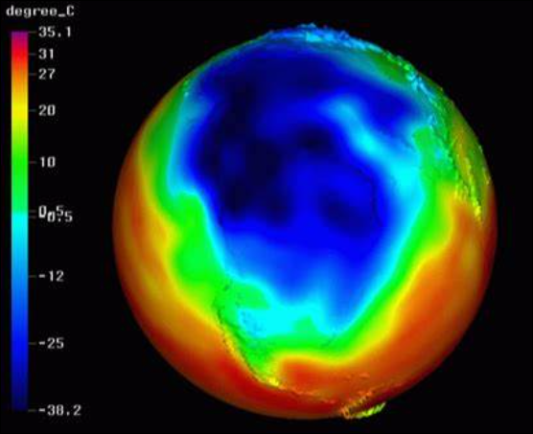
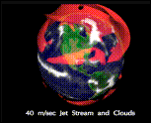
LESSON #1 Learning objectives
Differentiate between climate and weather
Identify a Global Circulation Model (GCM) created by atmospheric scientists
Recognize how human activity and human behavior limit the certainty of GCMs
Notes:
image sources:
https://www.youtube.com/watch?v=WyOsVnzkl3Y
http://www.essc.psu.edu/genesis/viz-agcm.html

Slide 7
Lesson #1 Global Weirding” (2018) by Katherine Hayhoe, PhD. atmospheric scientist & Chief Scientist at The Nature Conservancy
Notes:
Instructors/Students: WATCH this video “Global Weirding” (2018) by atmospheric scientist and Chief Scientist at The Nature Conservancy, Katherine Hayhoe, PhD.
Climate vs Weather | Global Weirding
Duration: 8:04 User: n/a - Added: 10/3/18
LESSON #1_ASSESSMENT
Complete the sentences using the word bank below.
1. The daily weather includes fluctuations in temperature, relative humidity, and atmospheric pressure at a small-scale over a short-time scale of several days.
2. It's average at the large-scale and over the longer-time scale of 20 to 30 years is called the climate.
3. To model climate and weather, atmospheric scientists derive GCMs, also called global circulation models using measurements of natural variability in the conservation of energy, the mass of water and the mass of air mass at the global scale.
4. Scientists also include measurements of regional- and local variability in air temperature, pressure, density, water vapor content, and wind magnitude in GCMs.
5. When creating and modifying GCMs to predict the future weather and future climate, atmospheric scientists, like Dr. Hayhoe must include uncertainties due to humanity. These are:
6. Human activity – For example, how will planet Earth respond to humans continually pumping carbon dioxide and other greenhouse gases into the atmosphere?
7. Human behavior – For example, which choices that humans make today will set the course of global climate in the future?
Word Bank:
activity
behavior
climate
general climate models
global circulation models
humanity
uncertainty
variability
weather
weather models

Slide 8
Lesson #1 Assessment
Complete each sentence using the word bank provided
1. The daily _____ includes fluctuations in temperature, relative humidity, and atmospheric pressure at a small-scale over a short-time scale of several days.
2. It's average at the large-scale, over the longer-time scale of 20 to 30 years is called the __.
3. To model climate and weather, atmospheric scientists derive GCMs, also called _____ using measurements of natural variability in the conservation of energy, the mass of water and the mass of air mass at the global scale.
4. Scientists also include measurements of regional- and local ______in air temperature, pressure, density, water vapor content, and wind magnitude in GCMs.
Word Bank:
activity behavior climate general climate models global circulation models humanity uncertainty variability weather weather models
Notes:
LESSON #1 ASSESSMENT
Complete the sentences using the word bank below.
1. The daily _____ includes fluctuations in temperature, relative humidity, and atmospheric pressure at a small-scale over a short-time scale of several days.
2. It's average at the large-scale and over the longer-time scale of 20 to 30 years is called the _____.
3. To model climate and weather, atmospheric scientists derive GCMs, also called _____using measurements of natural variability in the conservation of energy, the mass of water and the mass of air mass at the global scale.
4. Scientists also include measurements of regional- and local _____ in air temperature, pressure, density, water vapor content, and wind magnitude in GCMs.
5. When creating and modifying GCMs to predict the future weather and future climate, atmospheric scientists, like Dr. Hayhoe must include uncertainties due to _____. These are:
6. Human _____ – For example, how will planet Earth respond to humans continually pumping carbon dioxide and other greenhouse gases into the atmosphere?
Human _____ – For example, which choices that humans make today will set the course of global climate in the future?
Word Bank:
activity
behavior
climate
general climate models
global circulation models
humanity
uncertainty
variability
weather
weather models

Slide 9
Lesson #1 Assessment
5. When creating and modifying GCMs to predict the future weather and future climate, atmospheric scientists, like Dr. Hayhoe must include uncertainties due to ____________.
These are:
6. Human ________ -- For example, how will planet Earth respond to humans continually pumping carbon dioxide and other greenhouse gases into the atmosphere?
7. Human ________ -- For example, which choices that humans make today will set the course of global climate in the future?
Word Bank:
activity behavior climate general climate models global circulation models humanity uncertainty variability weather weather models
Notes:
LESSON #1 ASSESSMENT
Complete the sentences using the word bank below.
Complete the sentences using the word bank below.
1. The daily _____ includes fluctuations in temperature, relative humidity, and atmospheric pressure at a small-scale over a short-time scale of several days.
2. It's average at the large-scale and over the longer-time scale of 20 to 30 years is called the _____.
3. To model climate and weather, atmospheric scientists derive GCMs, also called _____using measurements of natural variability in the conservation of energy, the mass of water and the mass of air mass at the global scale.
4. Scientists also include measurements of regional- and local _____ in air temperature, pressure, density, water vapor content, and wind magnitude in GCMs.
5. When creating and modifying GCMs to predict the future weather and future climate, atmospheric scientists, like Dr. Hayhoe must include uncertainties due to _____. These are:
6. Human _____ – For example, how will planet Earth respond to humans continually pumping carbon dioxide and other greenhouse gases into the atmosphere?
Human _____ – For example, which choices that humans make today will set the course of global climate in the future?
Word Bank:
activity
behavior
climate
general climate models
global circulation models
humanity
uncertainty
variability
weather
weather models

Slide 10
LESSON #2 Learning objectives
Recognize the natural, global-scale phenomenon—Earth’s climate system
Identify the components of Earth’s climate system—
the atmosphere,
the hydrosphere,
the cryosphere,
the lithosphere (geosphere), and
the biosphere.
Determine the interactions and connections among and between Earth System components.

Slide 11
LESSON #2 Thinking in Systems
“Once we see the relationship between structure and behavior, we can begin to understand how systems work, what makes them produce poor results, and how to shift them into better behavior patterns.”
— Donella H. Meadows (2008)
Notes:
Donella Meadows (2008) Thinking in Systems: A Primer. Chelsea Green Publishing, White River, VT. 240 p.

Slide 12
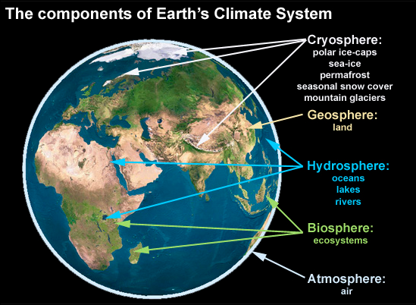
Lesson #2
Notes:
Source: https://skepticalscience.com/pics/climate-components.jpg
Students: Watch this video on the climate system. Observe how each component – cryosphere, geosphere, hydrosphere, biosphere, and atmosphere – contributes to the overall behavior of Earth’s climate.
Students: Click here for an explanation of the "Earth as a System."
Students: Review Table 1. Five Spheres of the Earth Climate System
Review the definition for each sphere.
Click on the NASA website to read about how each sphere interacts with the other four.

Slide 13
LESSON #2 The Climate system
Notes:
Students: Watch this video on the climate system. Observe how each component – cryosphere, geosphere, hydrosphere, biosphere, and atmosphere – contributes to the overall behavior of Earth’s climate.
Students: Click here for an explanation of the "Earth as a System.“
Students: Review Table 1. Five Spheres of the Earth Climate System
Review the definition for each sphere.
Click on the NASA website to read about how each sphere interacts with the other four.
Atmosphere
A mix of gases – nitrogen (78%), oxygen (21%), trace gases (methane, water vapor, etc.) ice crystals, aerosols, dust particles – forming a layer approximately 480-km thick around the Earth. The two layers that most influence climate at the Earth's surface are the troposphere and stratosphere.
About the Atmosphere_NASA
Biosphere
The parts of Earth where life exists – extending from the deepest root systems of trees to the dark environment of ocean trenches, to lush rain forests and high mountaintops. All living things on land, air, and oceans make up this component.
About the Biosphere_NASA
Cryosphere
Any place on Earth where water is in its solid form, where low temperatures freeze water and turn it into ice; and occurs in many places around the Earth in addition to the Arctic and the Antarctic. The name of this component comes from the Greek word for cold, "kryos."
About the Cyrosphere_NASA
Geosphere
Also called the lithosphere, it includes the rocky outer shell and inner crust of Earth. Land Surface includes geophysical processes and parameters involving the Earth’s land surfaces (e.g., surface temperature, soil moisture, vegetation cover, and land use).
About the Geosphere_NASA
Hydrosphere
The liquid water on Earth – mostly in the oceans, lakes, and rivers. It also includes the geophysical parameters that characterize the oceans (e.g., temperature, salinity, sea surface topography, chemistry/biology optics) operating at depth and at its surface.
About the Hydrosphere_NASA

Slide 14
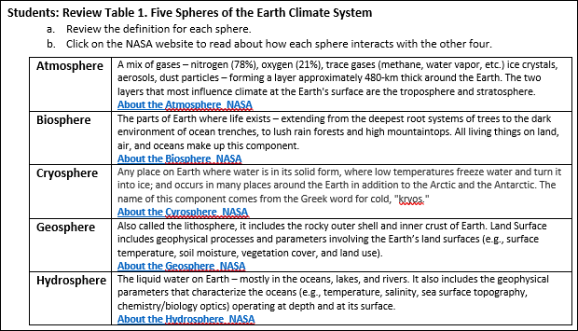
LESSON #2 Table 1
Notes:
Atmosphere
A mix of gases – nitrogen (78%), oxygen (21%), trace gases (methane, water vapor, etc.) ice crystals, aerosols, dust particles – forming a layer approximately 480-km thick around the Earth. The two layers that most influence climate at the Earth's surface are the troposphere and stratosphere.
CLICK on this LINK About the Atmosphere_NASA
Biosphere
The parts of Earth where life exists – extending from the deepest root systems of trees to the dark environment of ocean trenches, to lush rain forests and high mountaintops. All living things on land, air, and oceans make up this component.
CLICK on this LINK About the Biosphere_NASA
Cryosphere
Any place on Earth where water is in its solid form, where low temperatures freeze water and turn it into ice; and occurs in many places around the Earth in addition to the Arctic and the Antarctic. The name of this component comes from the Greek word for cold, "kryos."
CLICK on this LINK About the Cyrosphere_NASA
Geosphere
Also called the lithosphere, it includes the rocky outer shell and inner crust of Earth. Land Surface includes geophysical processes and parameters involving the Earth’s land surfaces (e.g., surface temperature, soil moisture, vegetation cover, and land use).
CLICK on this LINK About the Geosphere_NASA
Hydrosphere
The liquid water on Earth – mostly in the oceans, lakes, and rivers. It also includes the geophysical parameters that characterize the oceans (e.g., temperature, salinity, sea surface topography, chemistry/biology optics) operating at depth and at its surface.
CLICK on this LINK About the Hydrosphere_NASA

Slide 15
Lesson #2 ASSESSMENT
Imagine:
It is your job to detect subtle changes in Earth’s climate system.
Which component would you chose to monitor and why?
Please find the detailed instructions in the Notes section on this slide.
Notes:
LESSON #2 ASSESSMENT_ Short Essay/Class Discussion
CER Method for short answers and essays of at least 100 words.
Claim – A statement that answers the question.
Evidence – The scientific data and details that support your claim.
Reasoning – Explains the “who, what, when, where, why and how” the evidence supports your claim.
Imagine: It is your job to detect subtle changes in Earth’s climate system.
Which component would you chose to monitor and why?
Review the example below and a note: Please allow at least 30 minutes to write, re-write, edit and proof-read your essay.
CLAIM: I would monitor the hydrosphere because some of the liquid water, from oceans, evaporates into the atmosphere as water vapor. And, it’s likely that an increase in atmospheric water vapor could add to the energy trapping effect of greenhouse gases. If this causes additional global warming, it would be an example of a positive feedback to climate change.
EVIDENCE: Liquid water stored in surface water on Earth include the oceans (96.5%), groundwater (1.7%), soil moisture (0.001%), and lakes, swamps, rivers (0.023%), and the remaining 1.776 % is frozen as snow, ice or permafrost (Gleick 1996). Water changes state between solid, liquid and gas as a consequence of temperature and energy transfers.
REASONING: I would monitor the hydrosphere. Even a miniscule change in the hydrosphere, or the global water cycle, ought to lead to a detectable change in Earth’s climate. The oceans store most of Earth’s water (96.5% or 1,338,000 x 10³ km³), and a small fraction (0.032%) or 436.5 x 10³ km³/year evaporates from the oceans into atmosphere (Oki and Kanae 2006). Energy transfers occur when water changes state between solid, liquid and/or gas. The energy of evaporation breaks bonds between individual water molecules as liquid water converts to water vapor. As the Earth’s temperature increases, more water evaporates into the atmosphere and is stored as water vapor (Buis 2022). However, this increase does not function as a driver of global warming. It amplifies warming caused by other greenhouse gases (GHG) which, in turn, induce a positive feedback to global warming (Buis 2022). Just like when I take a shower, the bathroom warms up as the liquid water changes to- and is stored as steam. (163 words)
Literature Cited:
Buis, A. (2022). Steamy relationships: How atmospheric water vapor amplifies Earth’s Greenhouse Effect. Ask NASA Climate
Gleick, P.H. (1996) Water Resources. In: Schneider, S.H., Ed., Encyclopedia of Climate and Weather, Oxford University Press, New York, Vol. 2, 817-823.
Oki, T & S Kanae (2006) Global hydrological cycles and world water resources. Science 3133:1068-1072.

Slide 16
LESSON #3 Learning objectives
Explain how the Greenhouse Effect works influences Earth’s climate
Compare the Greenhouse Effect to an actual greenhouse
Distinguish between incoming solar radiation and outgoing radiation from Earth’s surface
Describe how carbon dioxide and methane trap outgoing radiation
Notes:
Ask yourself: Is the greenhouse effect a natural phenomenon, an anthropogenic phenomenon or a combination of both?

Slide 17
LESSON #3
Notes:
INSTRUCTIONS:
Navigate to NASA_Causes of Climate Change
Click on the The Greenhouse Effect on the left side of the NASA webpage
Watch the animation (~17 seconds) and use this explanation What is the greenhouse effect? (2:29 minutes)
Scroll through the website NASA_Climate_Kids for more details on the greenhouse effect

Slide 18
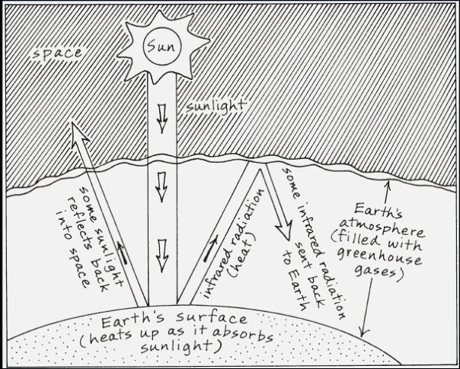
Lesson #3 ASSESSMENT
Grab a piece of paper, colored pens or pencils and use the figures for inspiration:
Draw the greenhouse effect
Label your completed drawing using all the terms on the next slide
Notes:
Draw this on your own, using the above images as a reminder of what to include in your drawing. It’s best to draw this several times to see you can do so from memory.
Label your drawing using all the terms below:
Earth’s surface
Earth’s atmosphere
The Sun
space
solar radiation (sunlight)
infrared radiation (heat)
reflected solar radiation
absorbed solar radiation
emitted solar radiation
short-wave radiation
long-wave radiation
reflected long-wave radiation
absorbed long-wave radiation
emitted long-wave radiation
greenhouse gases

Slide 19
Lesson #3 ASSESSMENT Label your Drawing using each of the terms below:
emitted solar radiation
short-wave radiation
long-wave radiation
reflected long-wave radiation
absorbed long-wave radiation
emitted long-wave radiation
greenhouse gases
Earth’s surface
Earth’s atmosphere
The Sun
space
solar radiation (sunlight)
infrared radiation (heat)
reflected solar radiation
absorbed solar radiation
Notes:
Label your drawing using all the terms below:
Earth’s surface
Earth’s atmosphere
The Sun
space
solar radiation (sunlight)
infrared radiation (heat)
reflected solar radiation
absorbed solar radiation
emitted solar radiation
short-wave radiation
long-wave radiation
reflected long-wave radiation
absorbed long-wave radiation
emitted long-wave radiation
greenhouse gases

Slide 20
LESSON #4 Learning objectives
Define and recognize a climate forcing
Define and recognize a climate feedback
Define and recognize a climate tipping point
Notes:
Earth's climate is a natural phenomenon and is studied by scientists from many disciplines. Three main drivers determine how the climate system behaves -- forcings, feedbacks, and tipping points.
Students: Navigate to the website https://climate.nasa.gov/nasa_science/science/.
LESSON #4 ASSESSMENT_ Fill in the blank.
The initial drivers of climate are called _____ and include solar irradiance, greenhouse gas emissions, and aerosols, such as ashes, smoke and soot. Scientists use them in GCMs to better predict the long-term climate regime on Earth.
Climate _____ are processes that can either amplify or diminish the effects of solar irradiance, greenhouse gas emissions, and aerosols, such as ashes, smoke and soot.
Events that increase an initial warming event are called "positive feedbacks." Events that reduce an initial warming event are called "negative feedbacks." The most powerful positive feedback is the ice _____, also known as ice reflectivity.
An abrupt move away from the stable state of Earth's climate system is called a _____and includes, changes in stable ocean circulation, ice loss, and methane releases.
The most powerful tipping point is thought to be _____ release into the atmosphere because it contributes to the atmospheric load of greenhouse gases and it derives from burning vast swathes of peatland and melting of the permafrost in the northern latitudes.
Word bank:
aerosol
albedo
CH₄ (methane)
CO₂ (carbon dioxide)
feedbacks
forcings
tipping point
tripping point

Slide 21
Lesson #4 ASSESSMENT
Fill in the blank using terms from the word bank.
The initial drivers of climate are called _____and include solar irradiance, greenhouse gas emissions, and aerosols, such as ashes, smoke and soot. Scientists use them in GCMs to better predict the long-term climate regime on Earth.
Climate ______are processes that can either amplify or diminish the effects of solar irradiance, greenhouse gas emissions, and aerosols, such as ashes, smoke and soot.
3. Events that increase an initial warming event are called "positive feedbacks." Events that reduce an initial warming event are called "negative feedbacks." The most powerful positive feedback is the ice __________, also known as ice reflectivity.
Word bank:
aerosol albedo CH₄ (methane) CO₂ (carbon dioxide) feedbacks forcings tipping point tripping point
Notes:
LESSON #4 ASSESSMENT_ Fill in the blank.
The initial drivers of climate are called _____ and include solar irradiance, greenhouse gas emissions, and aerosols, such as ashes, smoke and soot. Scientists use them in GCMs to better predict the long-term climate regime on Earth.
Climate _____ are processes that can either amplify or diminish the effects of solar irradiance, greenhouse gas emissions, and aerosols, such as ashes, smoke and soot.
Events that increase an initial warming event are called "positive feedbacks." Events that reduce an initial warming event are called "negative feedbacks." The most powerful positive feedback is the ice _____, also known as ice reflectivity.
An abrupt move away from the stable state of Earth's climate system is called a _____and includes, changes in stable ocean circulation, ice loss, and methane releases.
The most powerful tipping point is thought to be _____ release into the atmosphere because it contributes to the atmospheric load of greenhouse gases and it derives from burning vast swathes of peatland and melting of the permafrost in the northern latitudes.
Word bank:
aerosol
albedo
CH₄ (methane)
CO₂ (carbon dioxide)
feedbacks
forcings
tipping point
tripping point

Slide 22
Lesson #4 ASSESSMENT
Fill in the blank using terms from the word bank.
An abrupt move away from the stable state of Earth's climate system is called a __________ and includes, changes in stable ocean circulation, ice loss, and methane releases.
5. The most powerful tipping point is thought to be ______because it contributes to the atmospheric load of greenhouse gases and it derives from burning vast swathes of peatland and melting of the permafrost in the northern latitudes.
Word bank:
aerosol albedo CH₄ (methane) CO₂ (carbon dioxide) feedbacks forcings tipping point tripping point
Notes:
LESSON #4 ASSESSMENT_ Fill in the blank.
The initial drivers of climate are called _____ and include solar irradiance, greenhouse gas emissions, and aerosols, such as ashes, smoke and soot. Scientists use them in GCMs to better predict the long-term climate regime on Earth.
Climate _____ are processes that can either amplify or diminish the effects of solar irradiance, greenhouse gas emissions, and aerosols, such as ashes, smoke and soot.
Events that increase an initial warming event are called "positive feedbacks." Events that reduce an initial warming event are called "negative feedbacks." The most powerful positive feedback is the ice _____, also known as ice reflectivity.
An abrupt move away from the stable state of Earth's climate system is called a _____and includes, changes in stable ocean circulation, ice loss, and methane releases.
The most powerful tipping point is thought to be _____ release into the atmosphere because it contributes to the atmospheric load of greenhouse gases and it derives from burning vast swathes of peatland and melting of the permafrost in the northern latitudes.
Word bank:
aerosol
albedo
CH₄ (methane)
CO₂ (carbon dioxide)
feedbacks
forcings
tipping point
tripping point

Slide 23
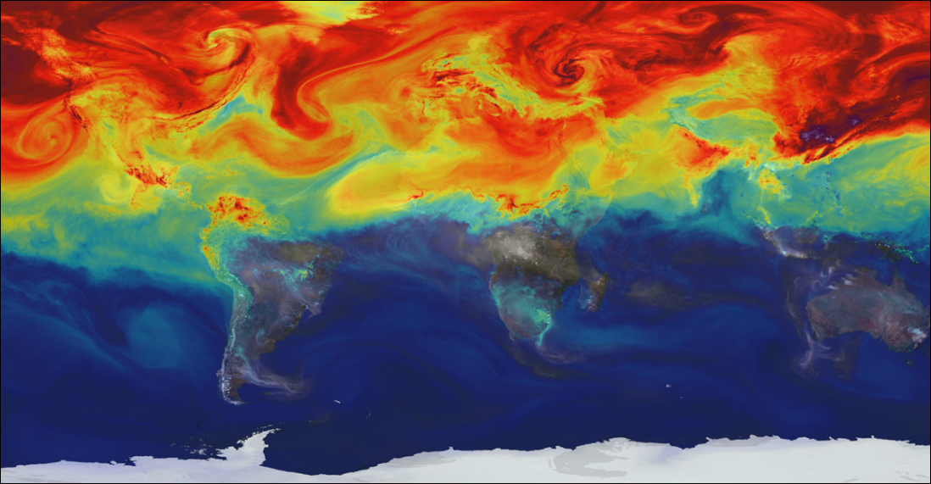
LESSON #5 Learning objectives
Explain radiative forcing
Identify 8 components of radiative forcing
Determine which component is the most powerful or the components that are the most significant
Notes:
https://climate.nasa.gov/news/3072/direct-observations-confirm-that-humans-are-throwing-earths-energy-budget-off-balance/
LESSON #5. Learning Objectives
Explain radiative forcing
Identify 8 components of radiative forcing
Determine which component is the most powerful or the components that are the most significant
Students: Navigate to MIT Climate Explainers or MIT_Climate Science, Risk & Solutions Guide to examine one example of a climate forcing mechanism, called radiative forcing.
Students: Review the graph below Energy Education_Radiative Forcing

Slide 24
LESSON #5 Instructions
Navigate to MIT Climate Explainers or MIT_Climate Science, Risk & Solutions Guide to study one climate forcing mechanism, called radiative forcing.
Notes:
https://climate.nasa.gov/news/3072/direct-observations-confirm-that-humans-are-throwing-earths-energy-budget-off-balance/
LESSON #5. Learning Objectives
Explain radiative forcing
Identify 8 components of radiative forcing
Determine which component is the most powerful or the components that are the most significant
Students: Navigate to MIT Climate Explainers or MIT_Climate Science, Risk & Solutions Guide to examine one example of a climate forcing mechanism, called radiative forcing.
Students: Review the graph in the next slide Energy Education_Radiative Forcing

Slide 25
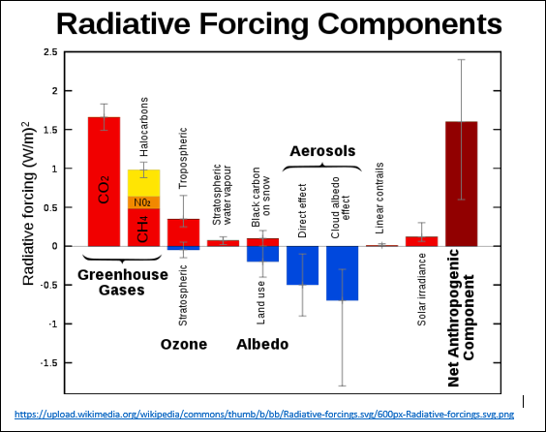
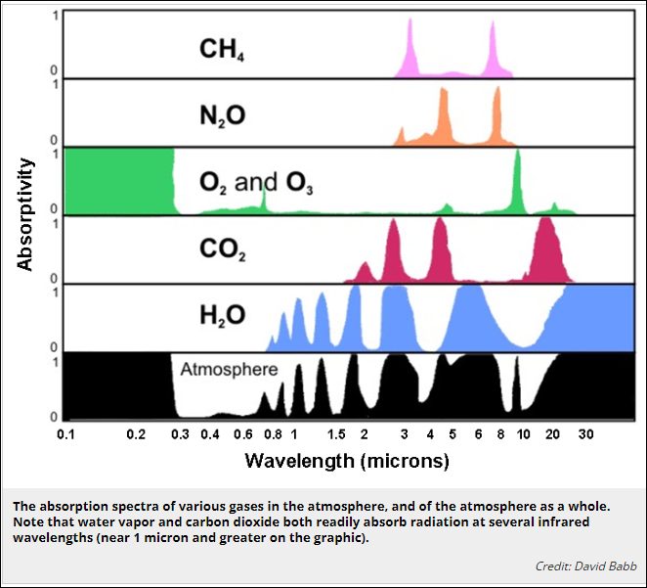
LESSON #5 Instructions
Navigate to https://energyeducation.ca/encyclopedia/Radiative_forcing
Read about: Radiative Forcing
Compare the graphs:
Notes:
https://climate.nasa.gov/news/3072/direct-observations-confirm-that-humans-are-throwing-earths-energy-budget-off-balance/
LESSON #5. Learning Objectives
Explain radiative forcing
Identify 8 components of radiative forcing
Determine which component is the most powerful or the components that are the most significant
Students: Navigate to MIT Climate Explainers or MIT_Climate Science, Risk & Solutions Guide to examine one example of a climate forcing mechanism, called radiative forcing.
Students: Review the graph below Energy Education_Radiative Forcing
https://www.e-education.psu.edu/meteo3/l2_p7.html

Slide 26
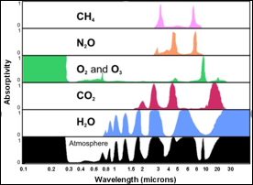
LESSON #5 ASSESSMENT
Explain how radiative forcing works to a friend.
Notes:
LESSON #5. Learning Objectives
Explain radiative forcing
Identify 8 components of radiative forcing
Determine which component is the most powerful or the components that are the most significant
Students: Navigate to MIT Climate Explainers or MIT_Climate Science, Risk & Solutions Guide to examine one example of a climate forcing mechanism, called radiative forcing.
Students: Review the graph below Energy Education_Radiative Forcing
https://www.e-education.psu.edu/meteo3/l2_p7.html

Slide 27
LESSON #5 ASSESSMENT
You tell your friend that radiative forcing is the difference between the amount of incoming solar radiation that strikes the Earth's surface and the amount of long wave radiation that is reflected back to space.
You also tell your friend, that based on their ability to trap outgoing longwave radiation, carbon dioxide and other greenhouse gases function as a heavy winter blanket thereby keeping the Earth warm.
True or False:
You simplify the concept of radiative forcing to the statement --"radiation in, radiation out" or "Power coming into Earth minus Power leaving the Earth = Radiative Forcing Amount."
Notes:
LESSON #5 ASSESSMENT_ You explain the concept of radiative forcing to a friend.
You tell them that radiative forcing is the difference between the amount of incoming solar radiation that strikes the Earth's surface and the amount of long wave radiation that is reflected back to space.
You also tell your friend, that based on their ability to trap outgoing longwave radiation, carbon dioxide and other greenhouse gases (such as CH₄ (methane) function as a heavy winter blanket thereby keeping the Earth warm.
True or False: You simplify the concept of radiative forcing to the statement--"radiation in, radiation out" which is the same as "Power coming into Earth - Power leaving the Earth = Radiative Forcing Amount."

Slide 28
LESSON #6 Learning objectives
Identify the greenhouse gases (GHG)
Describe the greenhouse warming potential (GWP) for each gas
Explain the source of each greenhouse gas
Determine which gases are from sources that are:
1. only anthropogenic (human)
2. only natural
3. both human and natural
Notes:
image source: https://climatekids.nasa.gov/greenhouse-cards/
Earth's climate is a natural phenomenon and is studied by scientists from many disciplines. Three main drivers determine how the climate system behaves -- forcings, feedbacks, and tipping points.
Students: Navigate to the website https://climate.nasa.gov/nasa_science/science/.

Slide 29
LESSON #6 Instructions
Watch this video What are the main greenhouse gases?
Based on what you know about GHG, which GHG come from natural sources and which GHG come from anthropogenic or human-made sources?
Interpret the graph
https://www.e-education.psu.edu/meteo3/l2_p7.html
Notes:
image source: https://climatekids.nasa.gov/greenhouse-cards/
Earth's climate is a natural phenomenon and is studied by scientists from many disciplines. Three main drivers determine how the climate system behaves -- forcings, feedbacks, and tipping points.
Students: Navigate to the website https://climate.nasa.gov/nasa_science/science/.
Students: Navigate to the website https://www.e-education.psu.edu/meteo3/l2_p7.html
Students: Watch this video What are the main greenhouse gases?

Slide 30
LESSON #6 Instructions
Locate the website: https://climatekids.nasa.gov/greenhouse-cards/
CLICK on each virtual card to learn about each greenhouse gas or review the next 6 slides.
Discover two things about each gas:
Does it come from natural or manmade sources?
Is it useful or harmful to life on Earth?
The main greenhouse gases are:
Water vapor (H₂O)
Carbon dioxide
Methane
Ozone
Nitrous oxide
Chlorofluorocarbons
Notes:
image source: https://climatekids.nasa.gov/greenhouse-cards/
Earth's climate is a natural phenomenon and is studied by scientists from many disciplines. Three main drivers determine how the climate system behaves -- forcings, feedbacks, and tipping points.
Students: Navigate to the website https://climate.nasa.gov/nasa_science/science/.
Students: Watch this video What are the main greenhouse gases?
https://www.kqed.org/quest/73097/what-are-greenhouse-gases-and-where-do-they-come-from
Now we are going to review each GHG starting with water vapor!

Slide 31
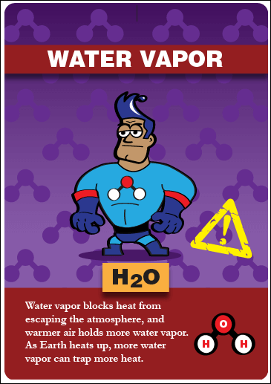
https://climate.nasa.gov/ask-nasa-climate/3143/steamy-relationships-how-atmospheric-water-vapor-amplifies-earths-greenhouse-effect/
Notes:
Is this gas produced naturally? If yes, where does it come from?
Is this gas man-made? If yes, how do humans produce this gas?
How is this gas useful to life on Earth?
How is this gas harmful to life on Earth?
https://climate.nasa.gov/ask-nasa-climate/3143/steamy-relationships-how-atmospheric-water-vapor-amplifies-earths-greenhouse-effect/#:~:text=Water%20vapor%20is%20Earth's%20most,gases%20keep%20our%20planet%20livable
https://www.e-education.psu.edu/meteo3/l2_p7.html

Slide 32
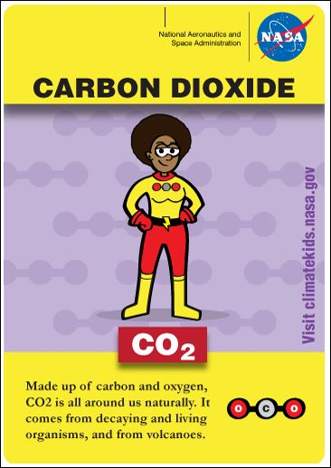
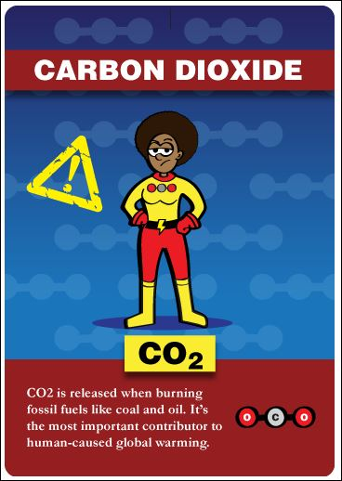
https://gml.noaa.gov/ccgg/trends/
Notes:
Is this gas produced naturally? If yes, where does it come from?
Is this gas man-made? If yes, how do humans produce this gas?
How is this gas useful to life on Earth?
How is this gas harmful to life on Earth?
https://gml.noaa.gov/ccgg/trends/

Slide 33
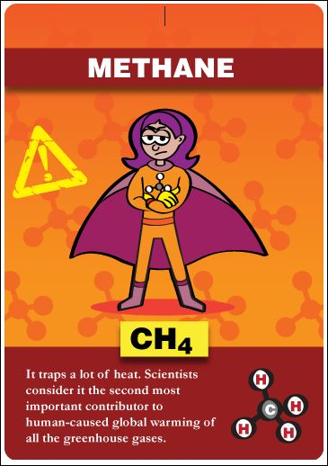
https://www.noaa.gov/news-release/increase-in-atmospheric-methane-set-another-record-during-2021
Notes:
Is this gas produced naturally? If yes, where does it come from?
Is this gas man-made? If yes, how do humans produce this gas?
How is this gas useful to life on Earth?
How is this gas harmful to life on Earth?
https://www.noaa.gov/news-release/increase-in-atmospheric-methane-set-another-record-during-2021

Slide 34
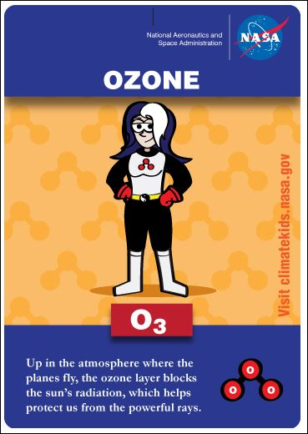
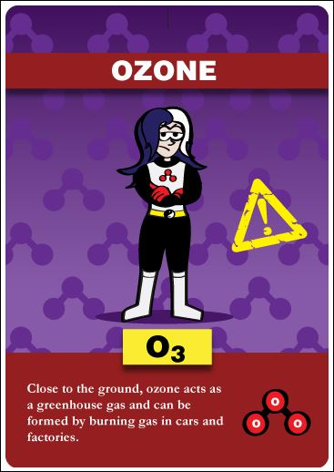
https://ozonewatch.gsfc.nasa.gov/
Notes:
Is this gas produced naturally? If yes, where does it come from?
Is this gas man-made? If yes, how do humans produce this gas?
How is this gas useful to life on Earth?
How is this gas harmful to life on Earth?
https://ozonewatch.gsfc.nasa.gov/

Slide 35
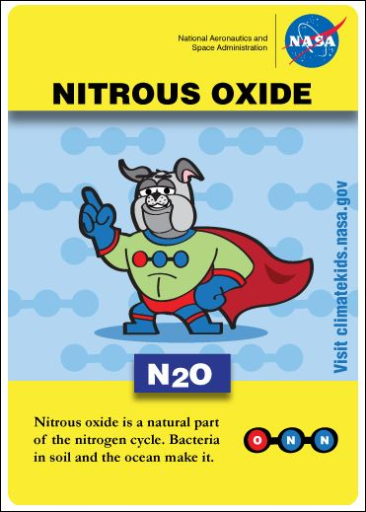
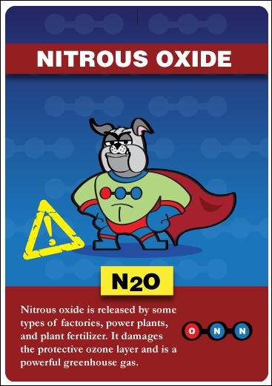
https://www.epa.gov/climate-indicators/climate-change-indicators-atmospheric-concentrations-greenhouse-gases
Notes:
Is this gas produced naturally? If yes, where does it come from?
Is this gas man-made? If yes, how do humans produce this gas?
How is this gas useful to life on Earth?
How is this gas harmful to life on Earth?
https://www.nature.com/articles/s41586-020-2780-0
https://www.epa.gov/climate-indicators/climate-change-indicators-atmospheric-concentrations-greenhouse-gases

Slide 36
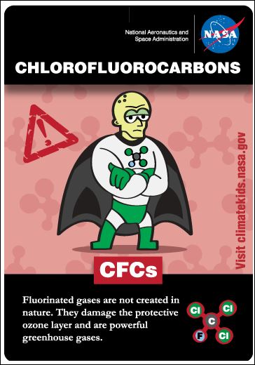
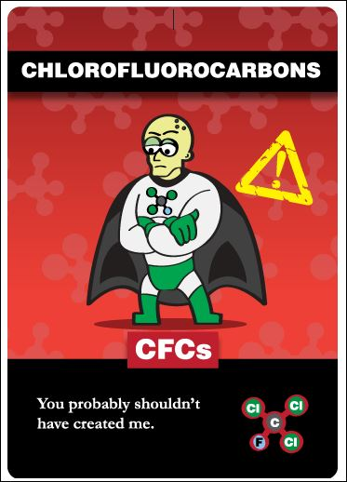
https://climate.mit.edu/ask-mit/what-concentration-cfcs-atmosphere-and-how-much-do-they-contribute-global-warming
Notes:
Is this gas produced naturally? If yes, where does it come from?
Is this gas man-made? If yes, how do humans produce this gas?
How is this gas useful to life on Earth?
How is this gas harmful to life on Earth?
https://climate.mit.edu/ask-mit/what-concentration-cfcs-atmosphere-and-how-much-do-they-contribute-global-warming

Slide 37
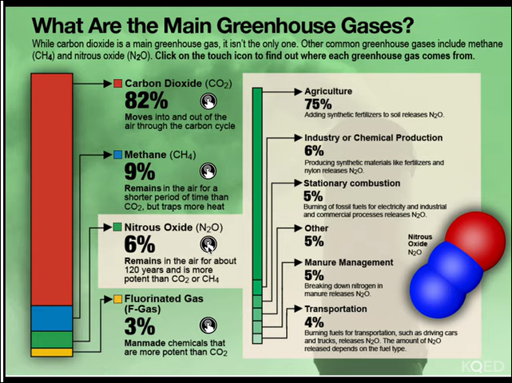
LESSON #6 ASSESSMENT_1a
N₂O
Did you notice the two images of nitrous oxide?
Can you identify which GHG the other superheroes represent?
Notes:
image source: https://climatekids.nasa.gov/greenhouse-cards/
LESSON #6_ASSESSMENT_1A_List the big six GHG!
1.
2.
3.
4.
5.
6.

Slide 38
LESSON #6 ASSESSMENT_1B
Based on what you know about the six main greenhouse gases (GHG), you have a conversation with your friends.
You tell your friends that we (humanity) should ignore the low atmospheric concentrations of methane (CH₄) from fracking and oil drilling sites and cattle and other ruminant animals, H₂O vapor, nitrous oxide (N₂O) from fossil fuel combustion, lightning, agriculture, and microbial processes, and man-made fluorinated gases (F-gas).
Your friends question your statement and ask why should we ignore the contribution of the greenhouse gases CH₄, H₂O vapor, N₂O and F-gases to global warming.
You answer that because the percentages of methane (CH₄), nitrous oxide (N₂O) and fluorinated gases (F-gas) are so small that they have no effect on radiative forcing.
True or False: Your reasoning is correct because you know that CO₂ is the only greenhouse gas that affects radiative forcing.
Notes:
LESSON #6_ ASSESSMENT_1B_ Review the graph below and have this exchange with your friends.
You tell your friends that we (humanity) should ignore the low atmospheric concentrations of methane (CH₄) from fracking and oil drilling sites and cattle and other ruminant animals, nitrous oxide (N₂O) from fossil fuel combustion, lightning, agriculture, and microbial processes, and man-made fluorinated gases (F-gas).
Your friends question your statement and ask why should we ignore the contribution of the greenhouse gases CH₄, N₂O and F-gases to global warming.
You answer that because the percentages of methane (CH₄), nitrous oxide (N₂O) and fluorinated gases (F-gas) are so small that they have no effect on radiative forcing.
True or False: Your reasoning is correct because you know that CO₂ is the only greenhouse gas that affects radiative forcing.

Slide 39
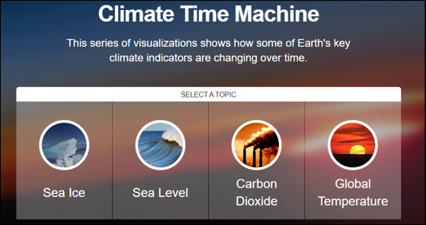
LESSON #7Learning objectives
Determine the trend in global temperature from 1990 to 2019
Determine the trajectory for atmospheric carbon dioxide concentrations from 2002 to 2016
NASA Climate Time Machine_2022
Notes:
image source: NASA Climate Time Machine_2022
https://climate.nasa.gov/interactives/climate-time-machine
Students: OPTIONAL REVIEW NASA website_Understanding our planet to benefit humankind

Slide 40
LESSON #7 Assessment GO TO: https://climate.nasa.gov/interactives/climate-time-machine
Click on the interactive link for global temperature. What has happened to global temperature from 1884 to 2021?
Increased
Decreased
Stayed the same
Click on the interactive link for carbon dioxide from 2002 to 2022. What happened to levels of carbon dioxide from 2002 to 2022?
Increased
Decreased
Stayed the same
Click on the interactive links for sea ice and for sea level. Are changes linked to temperature or CO₂?
Increased
Decreased
Stayed the same
Notes:
LESSON #7 ASSESSMENT
Students: Click on the interactive link for global temperature. What happened to global temperature from 1884 to 2021?
Increased
Decreased
Stayed the same
Students: Click on the interactive link for carbon dioxide from 2002 to 2022. What happened to levels of carbon dioxide from 2002 to 2022?
Increased
Decreased
Stayed the same
Students: Click on the interactive link for sea ice. Since 1979 what happened to levels of perennial sea ice?
Increased
Decreased
Stayed the same

Slide 41
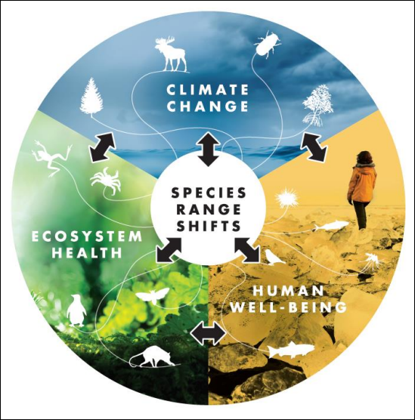
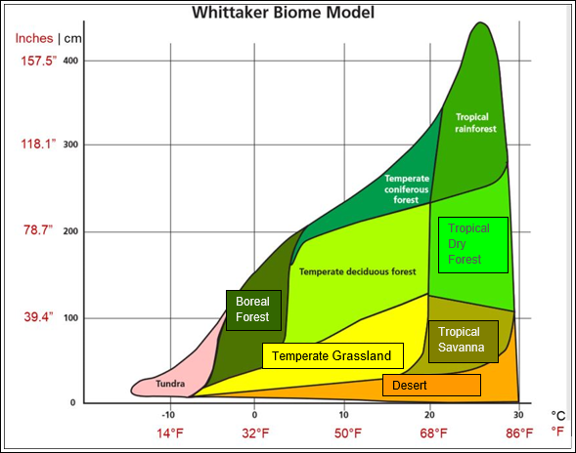
Lesson #8 Climate Change & Terrestrial Vegetation range shifts
Notes:
Using Models
In science, models often represent a hypothesis about how a system works. Recall that Whittaker’s Biome Model represents the global distribution of terrestrial biomes relative to the Earth’s mean annual temperature (MAT) and mean annual precipitation (MAP) – two factors related closely to climate.
Write down your thoughts and answer the following questions in the space provided. Make sure that each answer is between 50 and 100 words.
1. Explain the ecological concept that Whittaker’s Biome Model represents in terms of:
a. the x-axis and the y-axis
b. the relationship between the x-axis and the y-axis
c. the general environmental features of biomes
2. Pick one biome, name the selected biome, and describe how MAT and MAP vary over the biome. You may want to figure out the range of temperature (maximum and minimum) and the range of precipitation (maximum and minimum) for the biome.
3. Using the biome you described in question #2, predict and describe what might change in this biome’s environmental features if the global temperature increased or decreased by 1.5⁰ Celsius (2.7⁰Fahrenheit)?
4. Identify how the changes might be an advantage or a disadvantage to a population of plants, animals, insects and/or humans in the biome. Discuss the specific evidence supports your claim that the change was an advantage or a disadvantage to one group of living organisms, insects for example.
5. Describe how you used Whittaker’s Biome Model to predict the effect of global temperature on the environmental features of the biome you described in question #3.

Slide 42
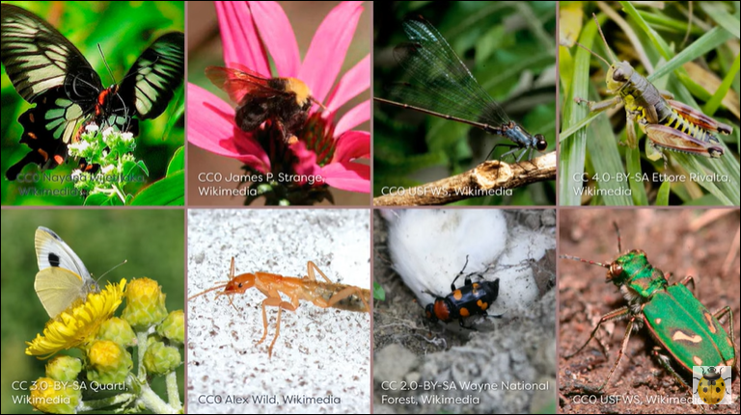
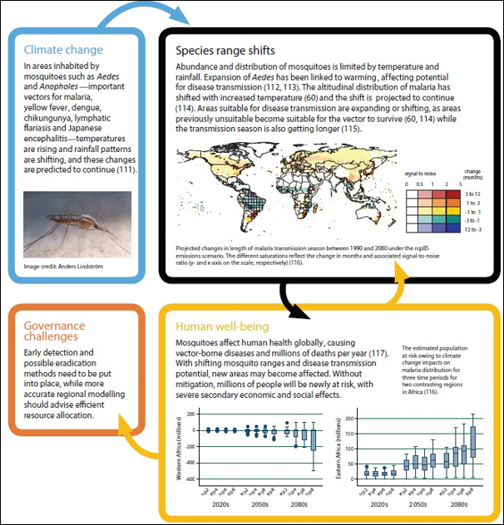
Lesson #8 Climate Change & Insect range shifts
Watch the video:
The Changing Climate and Insects
What is the temperature-size rule?
https://www.youtube.com/watch?v=giv-BM6PbbY
Notes:
Question: Why does the well-established temperature-size rule for insects create a conundrum for ecologists? How will this affect range expansion of ecothermic insects, especially disease-carrying mosquito species?
Relationships between environmental temperature and life history in ectotherms have puzzled biologists because of the paradoxical effects of temperature on growth rate and size at maturity: lower temperatures cause ectotherms to grow slower but mature at larger body sizes. In contrast, higher temperatures cause ecotherms to grow faster and reach sexual maturity more quickly to complete more generation per year, but mature at small body sizes.
Burraco P, Orizaola G, Monaghan P, Metcalfe NB. Climate change and ageing in ectotherms. Glob Change Biol. 2020;26:5371–5381.
https://doi.org/10.1111/gcb.15305 13652486, 2020, 10, Downloaded from https://onlinelibrary.wiley.com/doi/10.1111/gcb.15305, Wiley Online Library on [10/04/2023]. See the Terms and Conditions
(https://onlinelibrary.wiley.com/terms-and-conditions) on Wiley Online Library for rules of use; OA articles are governed by the applicable Creative Commons License
Pecl, G. T., Araujo, M. B., Bell, J., Blanchard, J., Bonebrake, T. C., Chen, I., Clark, T. D., Colwell, R. K., Danielsen, F., Evengard, B., Robinson, S. et al (2017). Biodiversity redistribution under climate change: Impacts on ecosystems and human well-being. Science, 355 (6332), 1-9.
Research Online is the open access institutional repository for the University of Wollongong. For further information contact the UOW Library: research-pubs@uow.edu.au

Slide 43
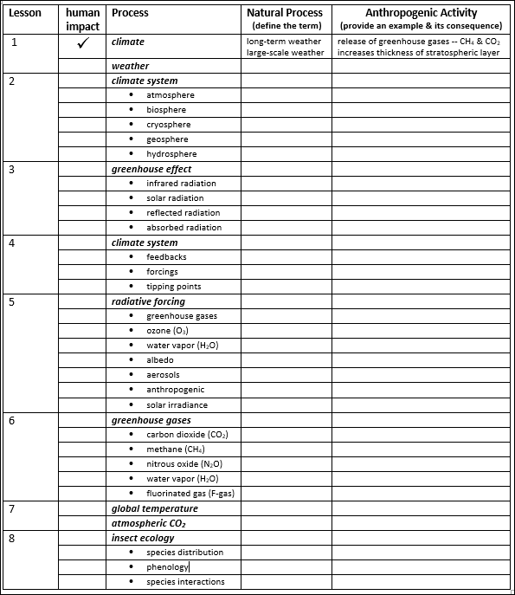
LESSON #9a Review
Natural processes in an ideal world show no influence of human activity
Anthropogenic activity alters natural processes in three ways – enhance (+), neutral (0), destabilize (-)
Note features of the natural processes covered in each of the preceding lessons
Note anthropogenic activity for each natural process with a check (✓ ) for yes and a dash (-) for no.
Notes:
Students_Complete the table.
The first row (Lesson #1 climate) shows expectations for a thorough, complete answer.

Slide 44
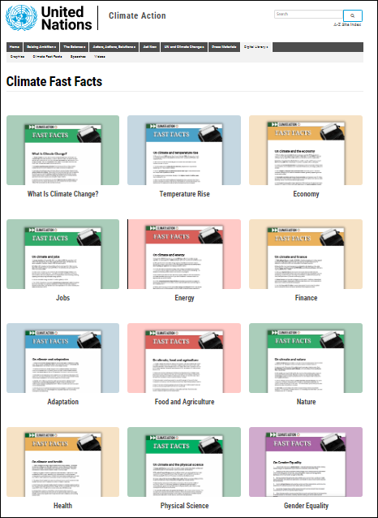
Lesson #9B Review
https://www.youtube.com/watch?app=desktop&v=S7jpMG5DS4Q
Notes:
https://www.youtube.com/watch?app=desktop&v=S7jpMG5DS4Q
https://www.un.org/en/climatechange/climate-fast-facts
LESSON #9b. REVIEW
Review the table completed for LESSON #8
Determine whether human activity affects each natural process (total the check marks)
Determine which natural processes are free from human activity (total the dashes)
Select the one natural process that appears to be most affected by anthropogenic activity
Select the one natural process that appears to be the least affected by anthropogenic activity
Students: Watch this oldie, but a goodie 2014_United Nations Climate Change video
Students: Pick one United Nations Climate Fast Facts
Students: Discuss your completed table, the video and one UN Climate Fast Fact
LESSON #9B_ASSESSMENT_ Summarize findings in three evidence-based statements:
1.
2.
3.

Slide 45
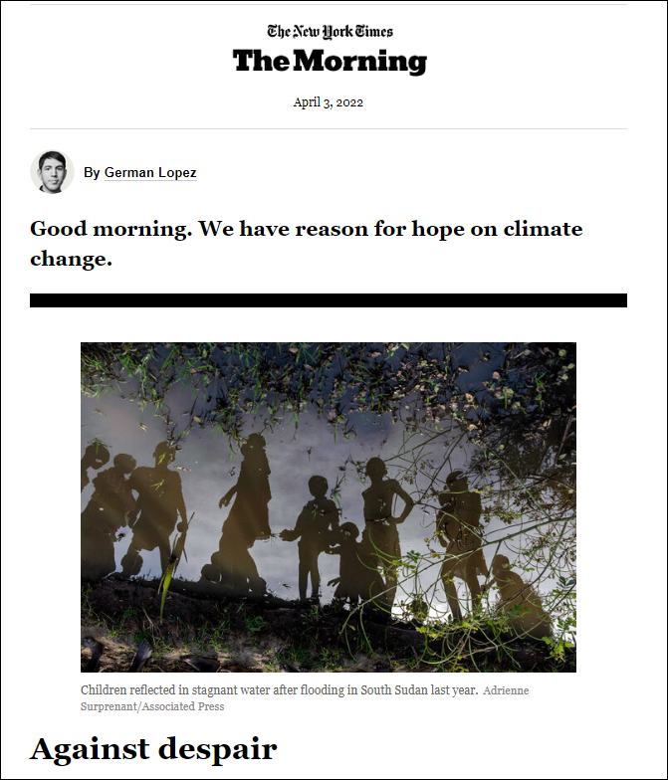
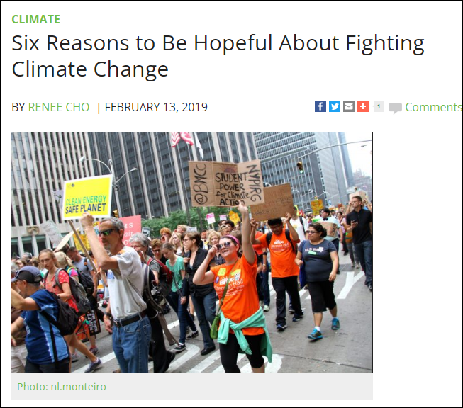
Lesson #10 Humanity needs hope!
Notes:
LESSON #10. Learning Objective
humanity needs hope
Students: Read this recent (April 3, 2022) New York Times article.
Students: Read this(February 13, 2019) article from Columbia University https://news.climate.columbia.edu/2019/02/13/hope-fighting-climate-change/
Students: THINK about this!
Do you agree with the author's claim -- Humanity can remain hopeful in the face of climate change?
Students: Skim the peer-reviewed article.
Frumkin, H. (2022) Hope, health, and the climate crisis. The Journal of Climate Change and Health. 5:100115
LESSON #10_ASSESSMENT_ Short Essay/Class Discussion:
Compose a short essay addressing the question – Can humanity be hopeful in the face of climate change?
Refer to the New York Times article, “Against Despair.”
Refer and cite to two peer-reviewed articles.
Use appropriate scientific terminology and grammatically-correct sentences.
CER Method for short answers and essays of at least 100-250 words.
Claim – A statement that answers the question.
Evidence – The scientific data and details that support your claim.
Reasoning – Explains the “who, what, when, where, why and how” the evidence supports your claim.

